Slide 1
Prototyping Deep Scalable Recommender System on AWS
Team 14
Abhinav Kumar
Chandrakanth Tolupunoori
Pranav Pura Lingaraju
Pranav Srinivas Nagavelli
Sanjana Mahabale
Tarun Newton

Slide 2

The Age of Search has come to an end
Chris Anderson in “The Long Tail”:
We are leaving the age of information and entering the age of recommendation
CNN Money, “The race to create a ‘smart’ Google”
The Web, they say, is leaving the era of search and entering one of discovery. What's the difference? Search is what you do when you're looking for something. Discovery is when something wonderful that you didn't know existed, or didn't know how to ask for, finds you.
Notes:
Especially relevant because of todays information overload.
https://www.slideshare.net/xamat/recommender-systems-machine-learning-summer-school-2014-cmu

Slide 3
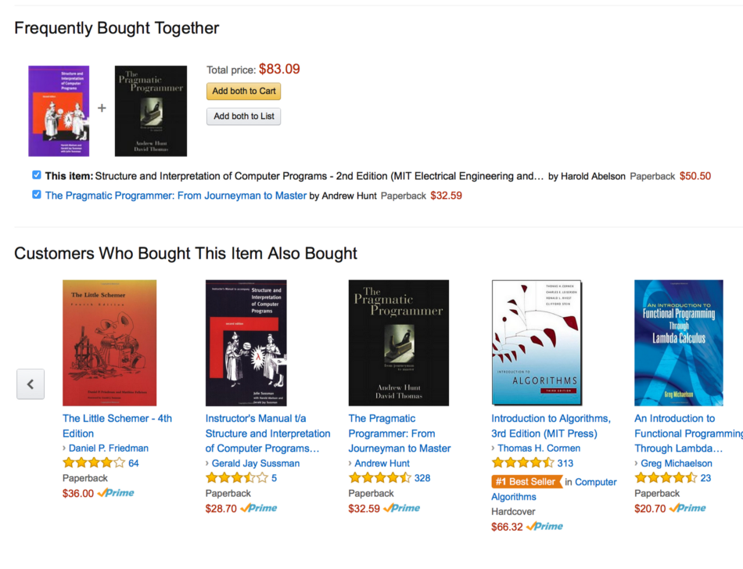
What are recommender systems?
A new age mechanism to recommend items or services to the customer based on their interests or of their look-a-likes to offer personalization

Slide 4



Influence OF Recommender Systems On Businesses
67%
Movies watched by Netflix customers are recommended movies
38%
Click Through Rates on Google News are through recommended links
35%
Sales at Amazon are through the product recommendations
https://www.oreilly.com/library/view/building-recommendation-engines/9781785884856/ch01s02.html

Slide 5
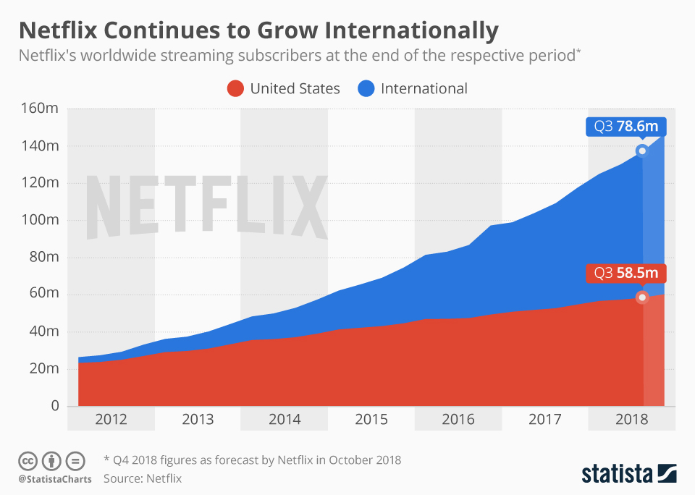
Need for scalable
solution
https://www.wired.com/2012/04/netflix-prize-costs/
Notes:
Without a doubt, big data is the driving force behind recommender systems. A good recommender engine should be reliable, scalable, highly available, and be able to provide personalized recommendations, in real time, to the large user base it contains.
https://github.com/lhduc94/IT-Ebook/blob/master/Building%20Recommendation%20Engines%20-%20Suresh%20Kumar%20Gorakala.pdf

Slide 6
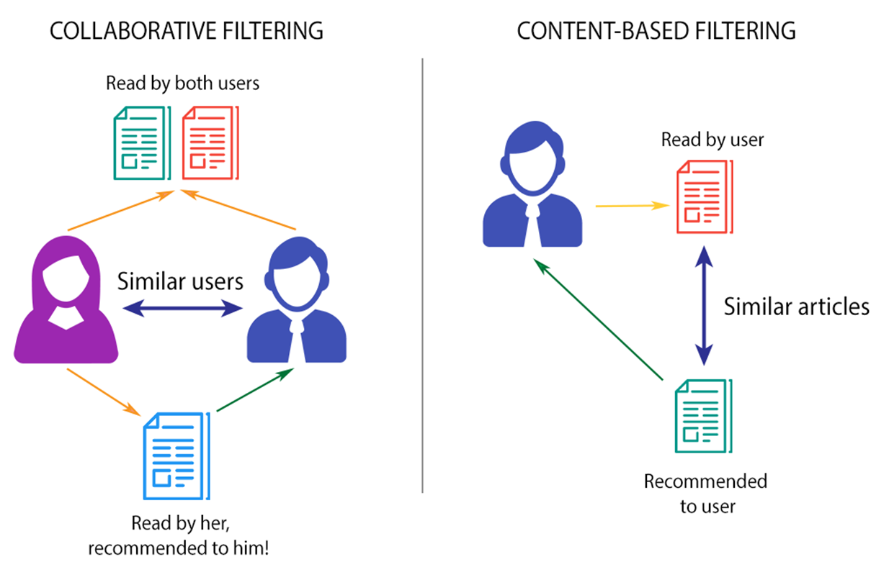
Types Of Recommender SYSTEMS
Content based filtering generates recommendations based on known user’s preferences
Collaborative filtering generates recommendations based on other user’s preferences

Slide 7
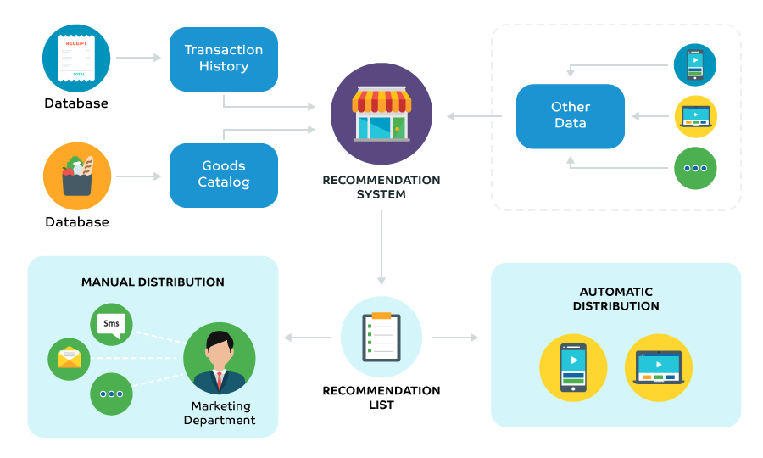
PIPELINE FOR RECOMMENDER SYSTEM

Slide 8
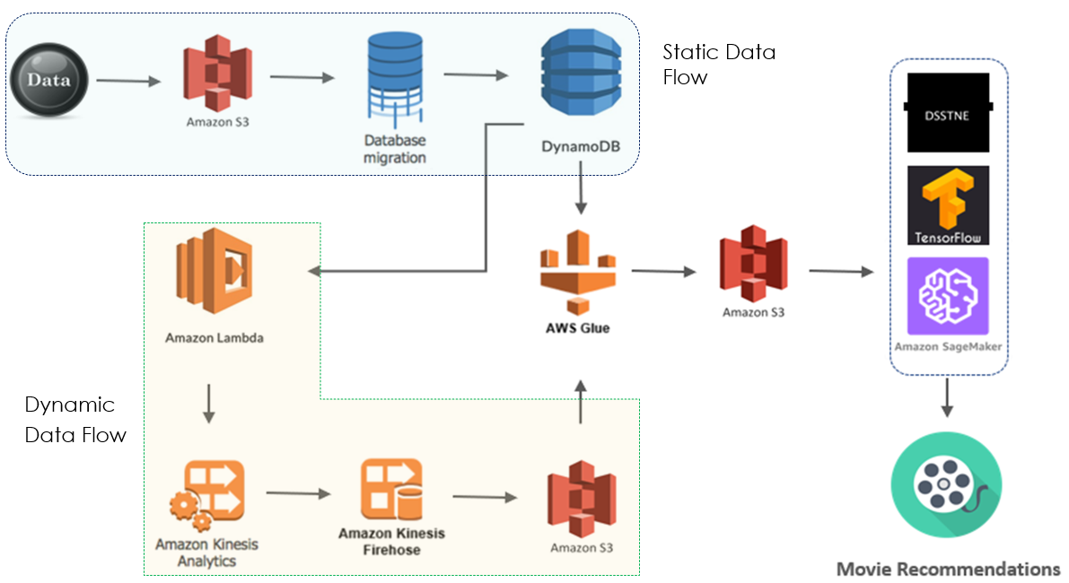
OUR IMPLEMENTATION ON AWS

Slide 9
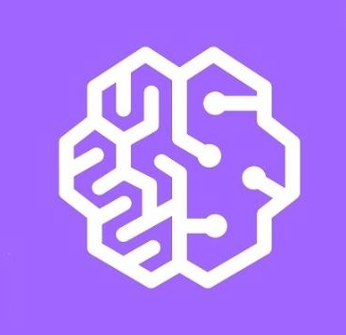
SageMaker FOR EasY Machine Learning Deployment
Fully managed service by AWS
Deploy the model in a simple API call
Build, train, and deploy machine learning models quickly and easily

Slide 10
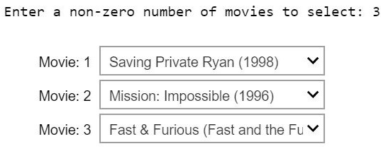
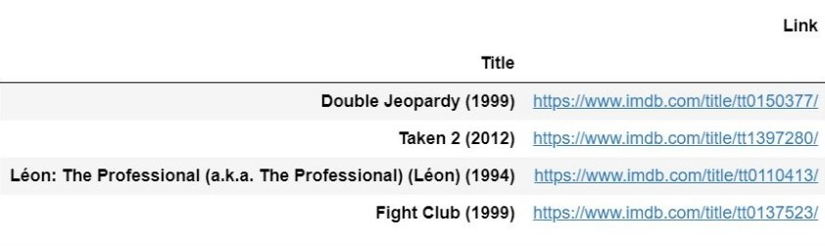
SAGEMAKER Recommender System
Input
Output

Slide 11
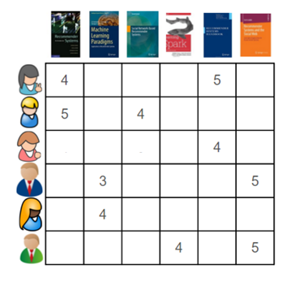
Limitations of sagemaker
Preprocessing currently done in SageMaker which is not scalable
Complex models fail on large datasets
High latency in training due to sparsity

Slide 12

DSSTNE SOLVES Sparsity in large data
DSSTNE (Deep Scalable Sparse Tensor Network Engine) is an open source neural network framework by Amazon
Implements model parallelism
‘Automagic’ multi-GPU support and scaling
Deterministic execution
16x faster than TensorFlow to train model on MovieLens

Slide 13
Limitations of DSSTNE
DSSTNE currently has not much support
Requires a GPU. No option to run on CPU, not even for development
Set up instructions for Ubuntu only
Uses JSON to build the network architecture, which limits what can be built

Slide 14
Recommendations
SageMaker for Small Businesses
DSSTNE for Large Businesses
DSSTNE
Scalability
Complexity

Slide 15
Thanks!
ANY QUESTIONS?

